Slide 1
NAP5

Slide 2
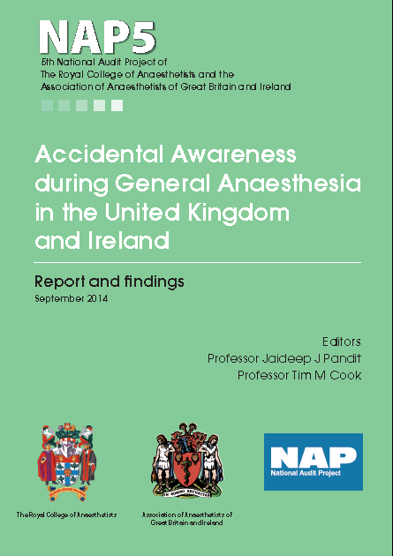
NAP5
Biggest
Hardest
Most patient facing

Slide 3
NAP5 in one slide
NMB bad, bad, bad
Induction high risk
Obstetric high risk
STP and RSI high risk
Out of hours and junior may increase risk
ETAG not enough
TIVA – beware non TCI and non theatre
DOA with NMB and additional risk factors…inc TIVA
Paralysis causes distress – 53%
Distress leads to sequelae – 42%
Syringe swaps are a nightmare
Sedation without communication leads to reports of AAGA
Its all about consent
10-20% compliant 5% litigate

Slide 4

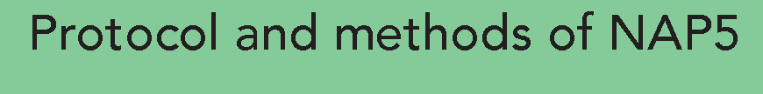
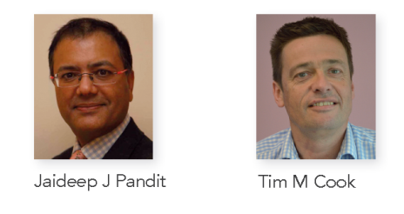

Slide 5
Methods
Broadly as for NAP3, NAP4
All UK NHS hospitals
Service evaluation
I year registry
New for NAP5
- Inclusion of Ireland
- Negative reporting
- Collaboration AAGBI + RCoA

Slide 6
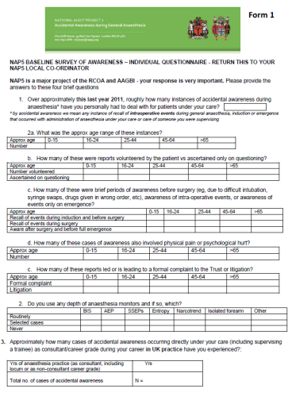
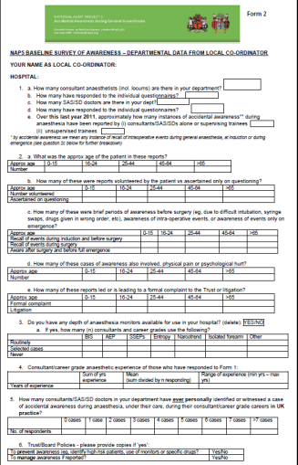
Individual and department forms
Baseline survey

Slide 7
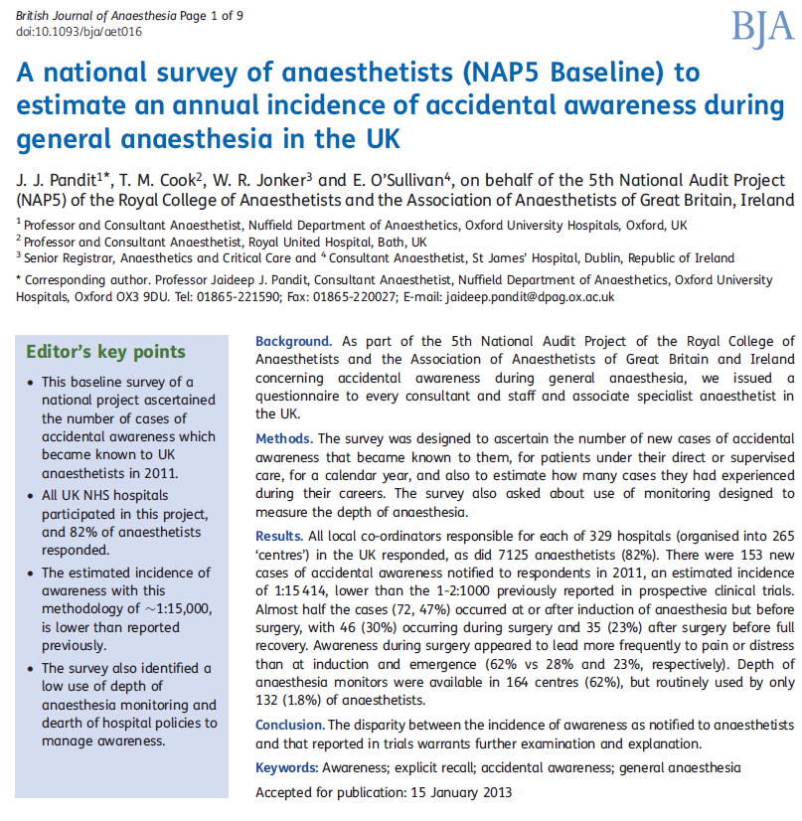
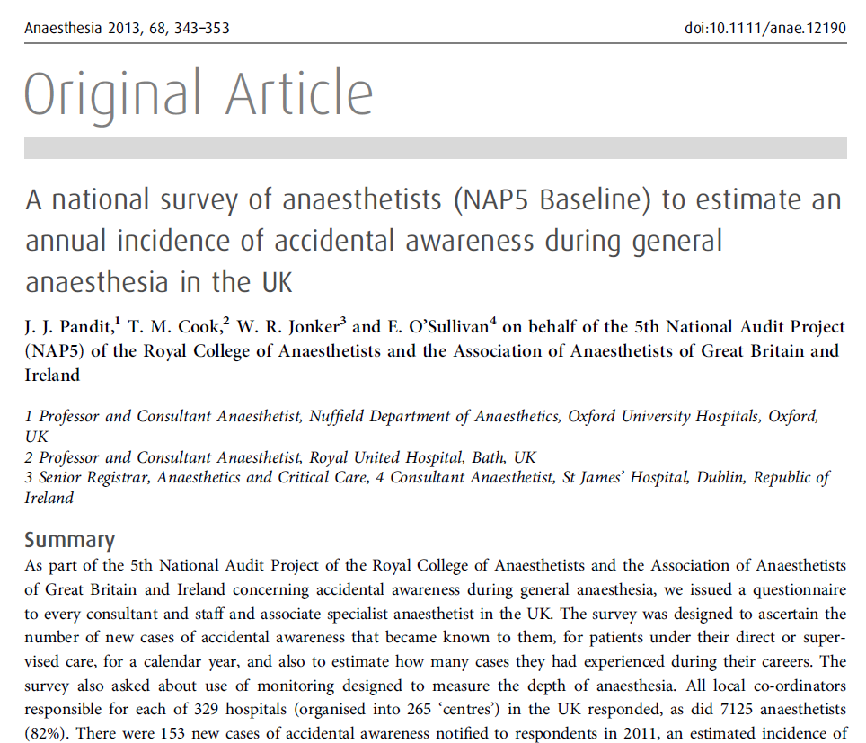
April
2013
153 reports of AAGA in 2011
Reports ≈ 1:15,000 GAs
Limited use of DOA
Minimal AAGA pathways

Slide 8
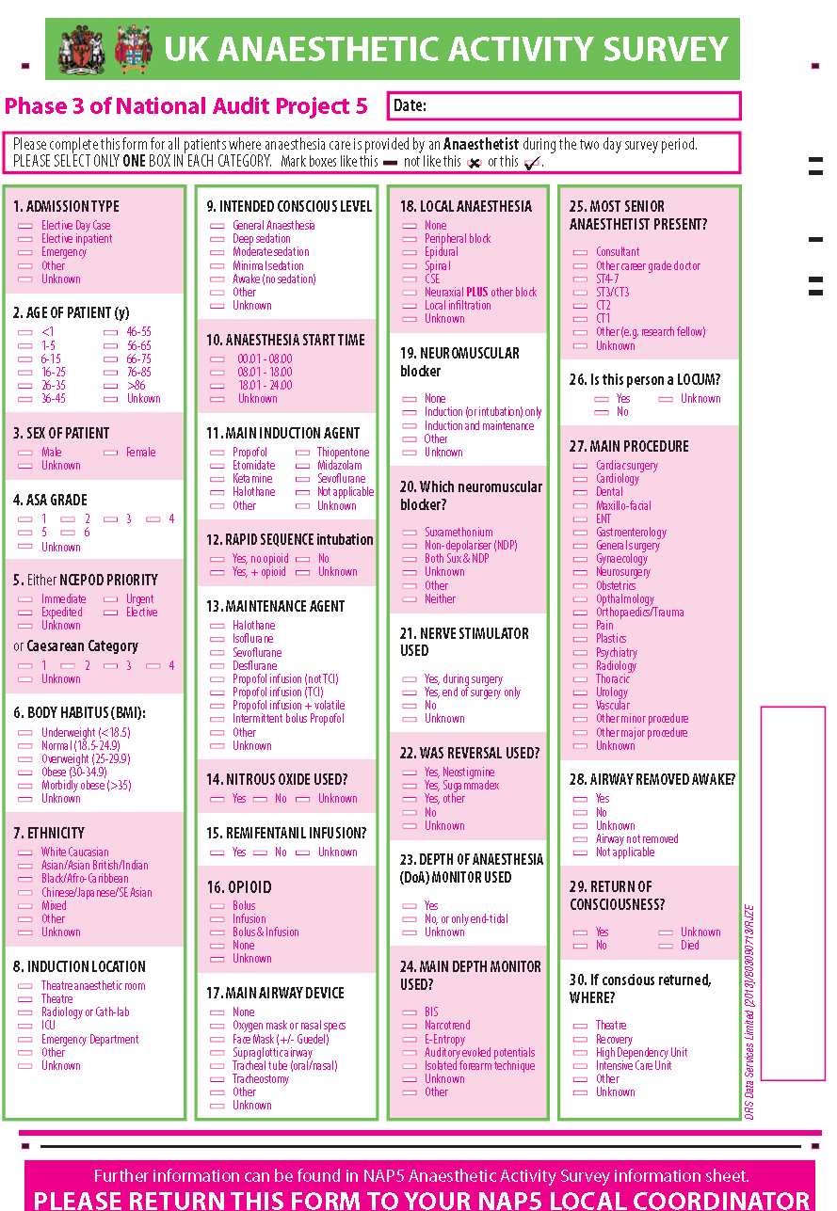
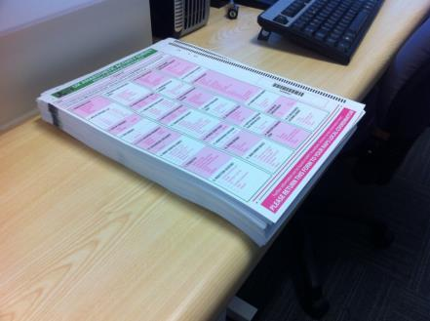
UK Activity survey
100% returns
>20,000 cases

Slide 9
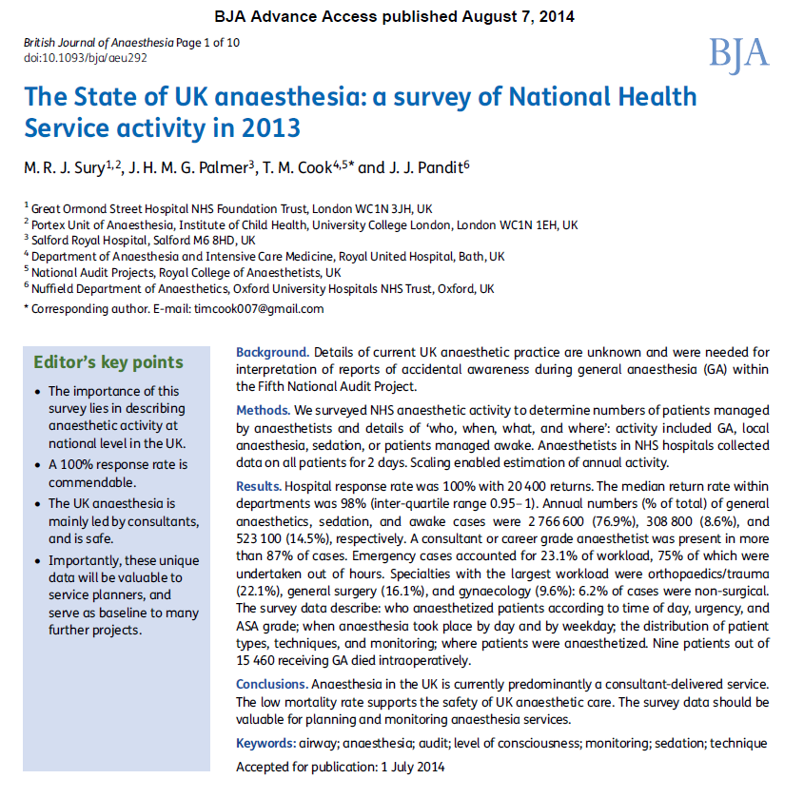
NAP5 denominator

Slide 10
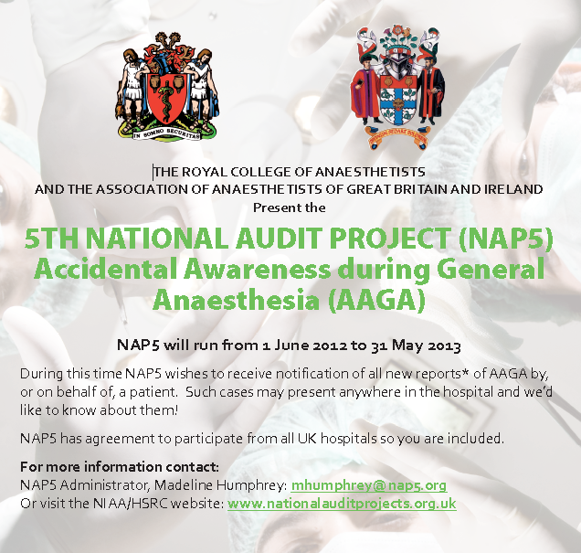

Slide 11
Inclusion criteria
a new patient report
made between 1 June 2012 - 31 May 2013
that they had been aware for a period of time when they expected to be unconscious.

Slide 12
The NAP firewall
i Anonymous report to administrator
ii Verification questions
iii Automated remote release of username and password
iv Mandated password change at first log on
v Report to secure, encrypted website (no identifiers)
vi Completed report mailed to NAP lead
vii Screening of reports for identifiers
Vii Report for review

Slide 13
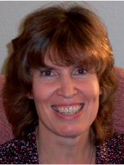
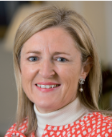
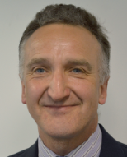


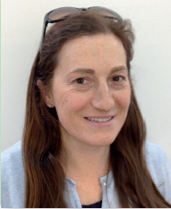


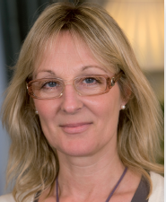
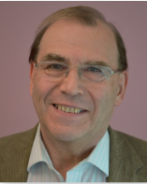
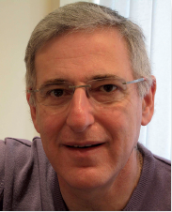
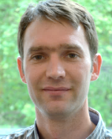
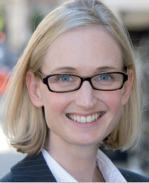



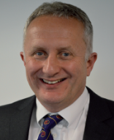
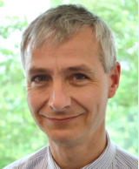
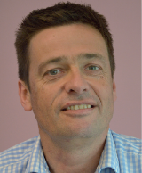
Review panel
Panel

Slide 14
NAP5 panel
Including …..
  Patient representatives
  President AAGBI
  2 council members RCoA
  3 council members AAGBI
  President CAI
  Editor-in-Chief BJA
  President SIVA
  President OAA
  Psychologists, psychiatrists
  5 Profs etc etc

Slide 15
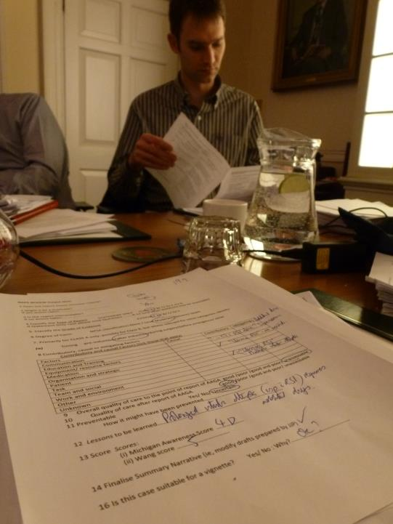

Slide 16
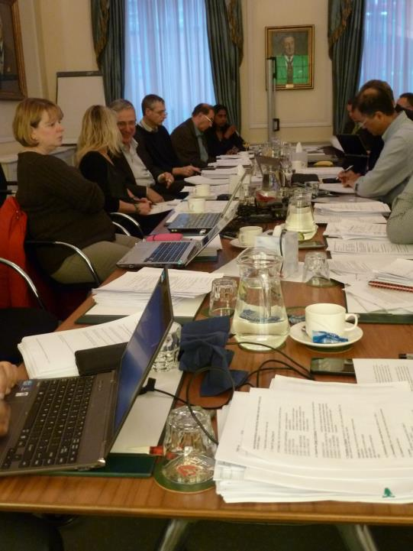

Slide 17
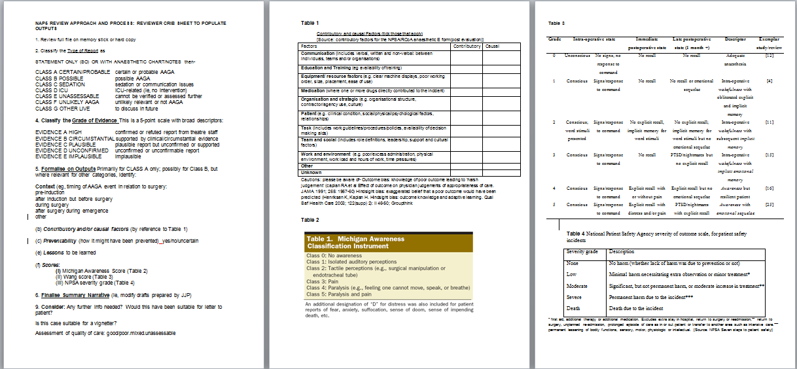
Structured outputs

Slide 18
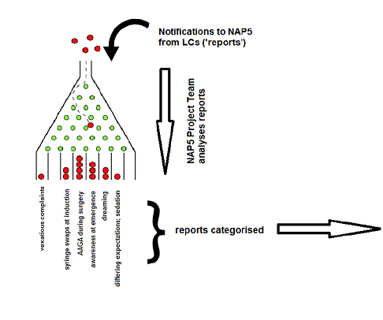
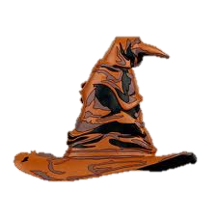

Slide 19
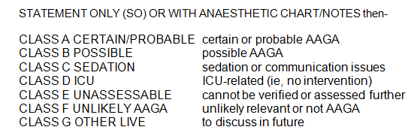
Classification: Type of AAGA

Slide 20
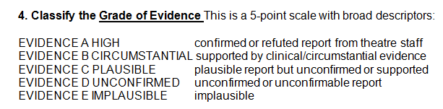
Classification: Evidence

Slide 21
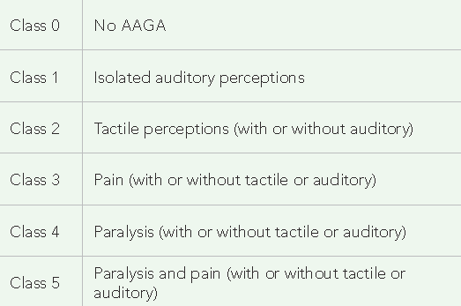
Michigan Classification: patient experience
Michigan awareness classification tool
Mashour et al A&A 2010; 110: 813-5

Slide 22
Michigan Classification
: patient experience
Add ‘D’ for distress
Michigan awareness classification tool
Mashour et al A&A 2010; 110: 813-5

Slide 23
Classification
Quality of care pre-AAGA
Quality of care post-AAGA report
good/poor/good and poor/unassessable
Preventability
yes/no/unassessable
Wang M. 2009

Slide 24
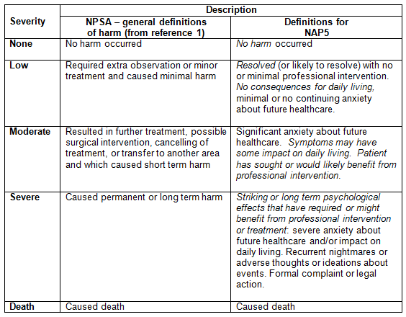
Classification: Degree of harm

Slide 25
Summary of review process
structured expert dual consensus review
with structured output
expert exploration of the truth:
not ‘the truth’

Slide 26
Before NAP5

Slide 27
Before NAP5
Prospective unselected series
Ranta (1998, Finland) 19 cases (2,612)
Sandin (2000, Sweden) 19 cases (11,785)
Myles (2000, Aus) 11 cases (10,811)
Wennervirta (2002, Finland) 4 cases (3,843)
Sebel (2004, USA) 25 cases (19,575)
Errando (2008, Spain) 22* cases (4,001)
Mashour(2012, USA) 5 cases (3,384)
Pollard (2007, USA) 6 cases (87,361)
39 AAGA but only 22 with details*

Slide 28
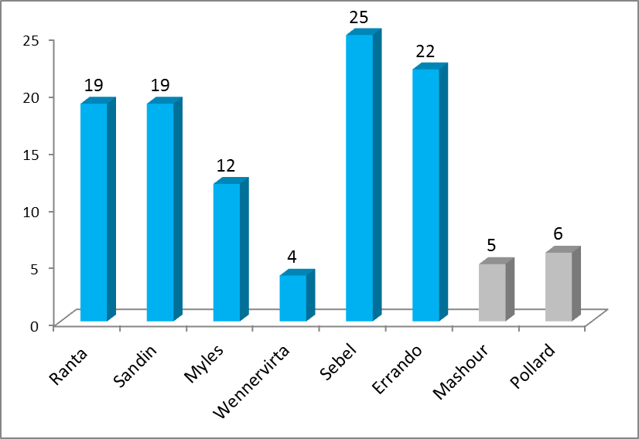
Before NAP5
Prospective unselected series

Slide 29
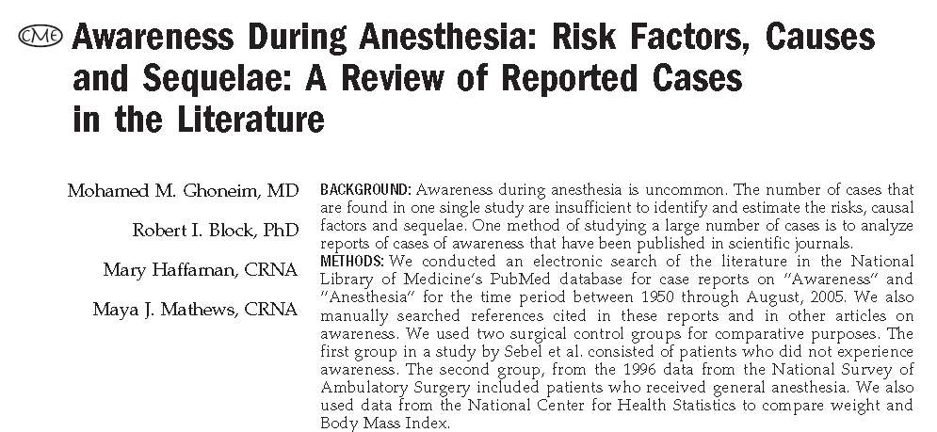
Before NAP5
All cases in literature 1950-2005
N=271
Anesthesia and analgesia 2009; 108: 527-35

Slide 30
NAP5
Ranta (1998 Finland) 19 cases (2,615)
Sandin (2000, Sweden) 19 cases (11,785)
Myles (2000, Aus) 11 cases (10,811)
Wennervirta (2002, Finland) 4 cases (3,843)
Sebel (2004, USA) 25 cases (19,575)
Errando (2008, Spain) 22* cases (4,001)
NAP5 300 cases reviewed
≈250 cases included
39 AAGA but only 22 with details*

Slide 31
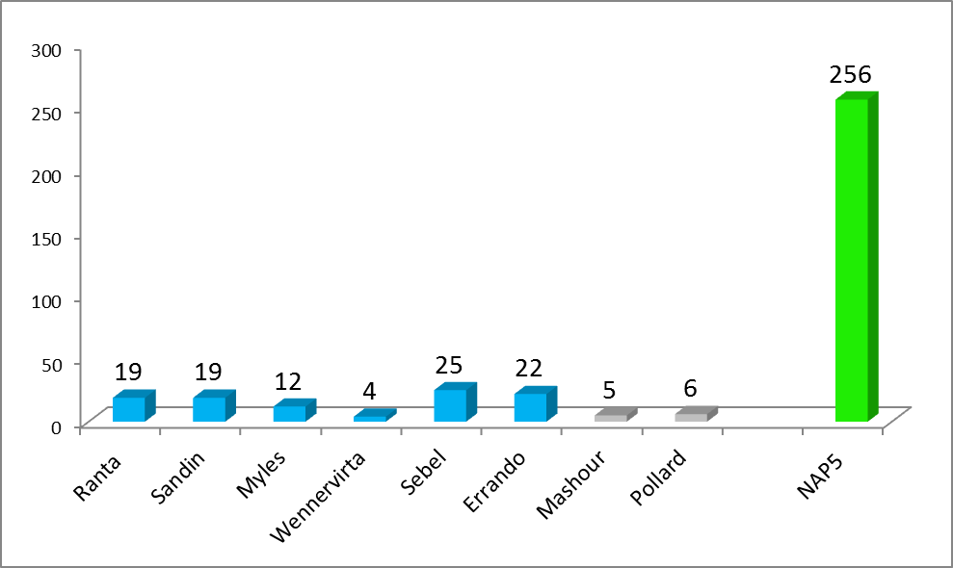

Slide 32
NAP5
Results

Slide 33
The United Kingdom of anaesthesia
UK Baseline 100% hospitals
UK Baseline 82% of senior anaesthetists
Baseline Ireland 100% hospitals
Baseline Ireland 87% consultants
UK activity survey 100% hospitals
UK activity survey 98% capture
Irish activity survey 100% hospitals
Irish Activity survey 96% capture
AAGA reports 100% UK hospitals
AAGA reports 100% Irish hospitals

Slide 34
Cases reported
269 UK centres
108 filed zero returns over the year
161 (60%) centres had a report
471 requests to upload data
341 logins issued (130 inadmissible)
321 logins used (20 unused)
300 accepted (21 judged inadmissible)

Slide 35
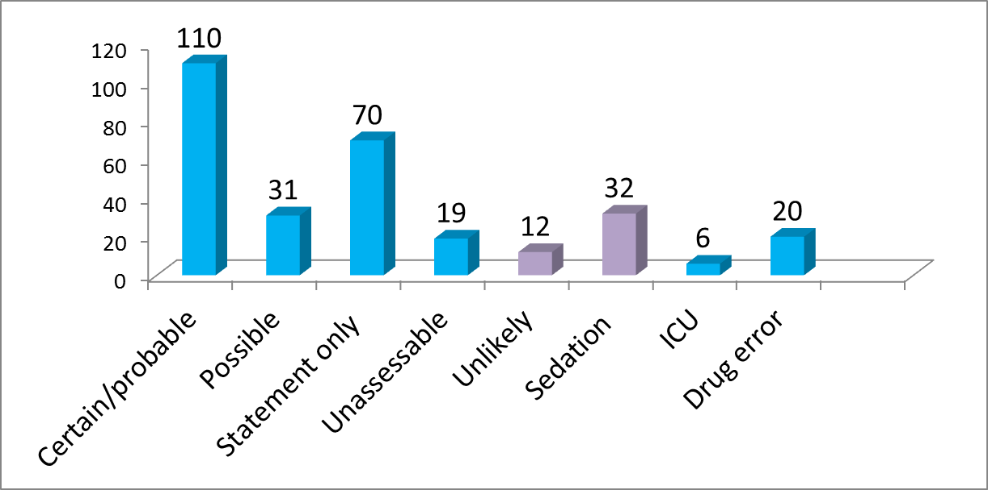


Classification

Slide 36
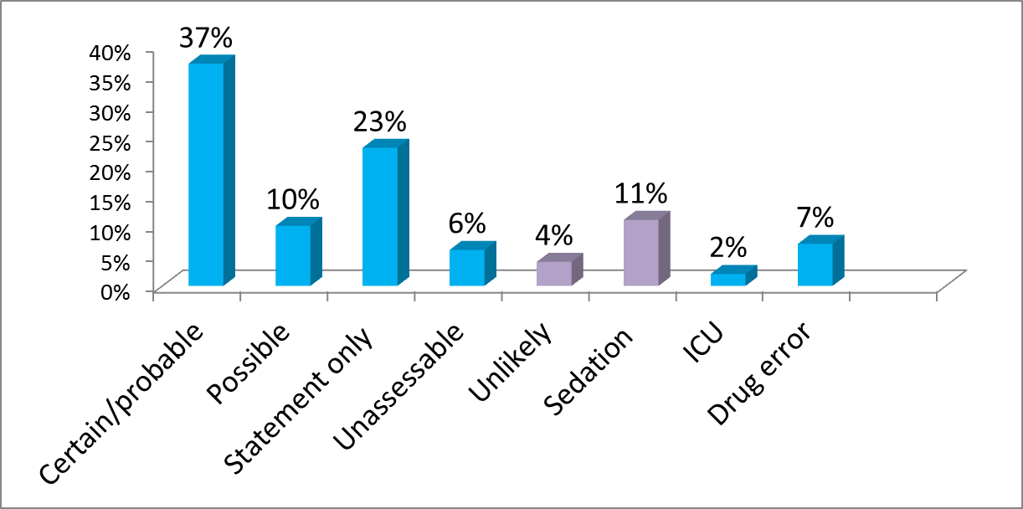
Percentages

Slide 37
Main focus is on certain/probable and possible reports (n=141)
We can compare % Activity Survey vs AAGAs ‘relative risk’ or ‘hazard ratio’
In following graphs, proportions
  Lines = Activity Survey
  Bars = AAGA

Slide 38
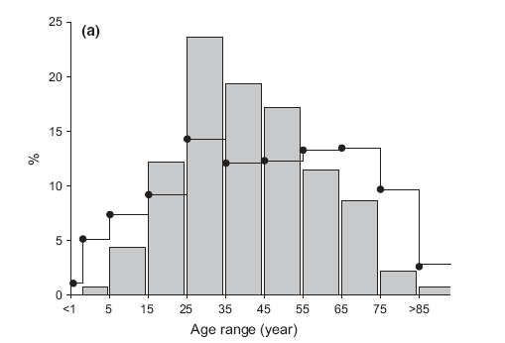
Age
AAGA most in young/middle age adults (viz. Baseline)

Slide 39
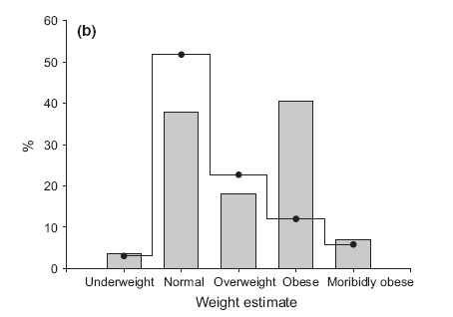
Weight
AAGA more in obese

Slide 40
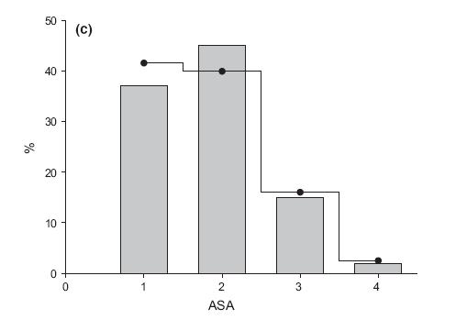
ASA
Not influential

Slide 41
When?
Emergence
18%
Induction
48%
Maintenance
34%

Slide 42
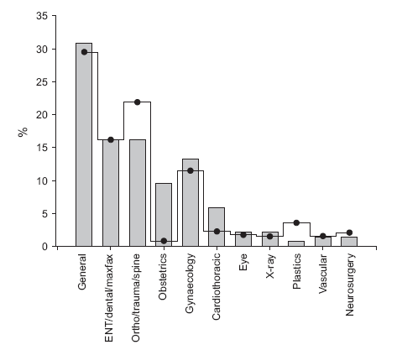
Types of surgery
Obstetrics x11
Cardiothoracic x3

Slide 43
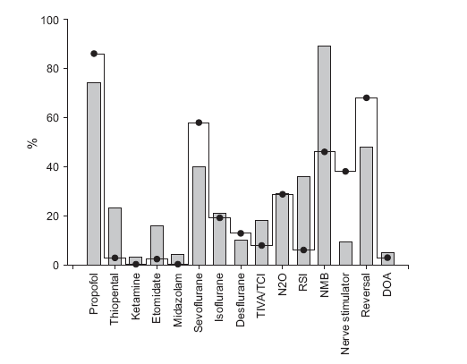
Modes of anaesthesia
Full profile

Slide 44
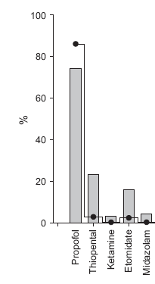
Induction
Clear message
Thiopentone:
RSI
Obstetrics
3% of all inductions
87% if RSI inductions
Less clarity
Etomidate?
Ketamine?
Midazolam?

Slide 45

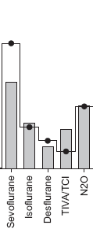
Maintenance
TIVA a risk?
Minor matters
N₂O ‘neutral’
??Sevo protective??
(agent-specific effects?)

Slide 46

NMB
The ‘unholy trinity’ that leads
to AAGA
Patients with AAGA
- NMB more likely
- nerve stimulator less likely
- Reversal less likely

Slide 47
“Incidence”
Incidence of what?
AAGA highly heterogeneous
Different methods look at different things
IFT = 1 in 3
Brice = ~1:600
Baseline = ~1:15,000
NAP5 main study 1: 20,000 - aggregate

Slide 48
Incidence subgroups…
All patient reports valid, substantiated or not (n = 471)
1: 6,000
Admissible patient reports (n = 300)
1: 12,000

Slide 49
Certain/probable or possible only (n = 141)
1: 20,000

Slide 50
When no NMB used
1 : 136,000
When NMB used
1: 8,200

Slide 51
Cardiothoracic
1 : 8,000 (same as NMB)
Caesarean section
1: 670 (close to Brice)

Slide 52
Paediatric
1: 61,000
After sedation by anaesthetists (AAGA reports)
1: 15,000
(AAGA more common after sedation than GA)

Slide 53
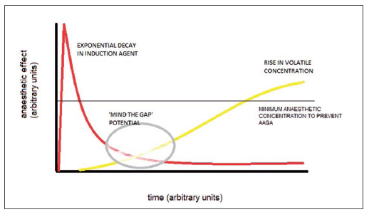
Induction
The ‘Gap’

Slide 54
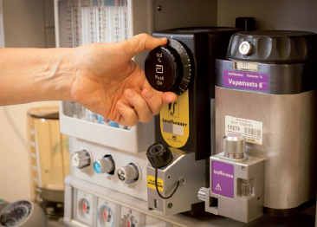
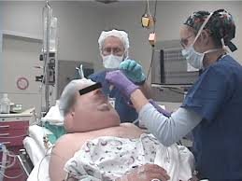
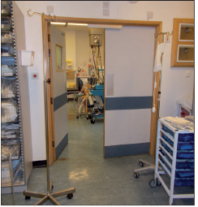
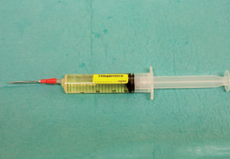
The gap
Causes of the gap
Prolonged intubation (thiopentone)
Redistribution (thiopentone)
Obesity
Anaesthetic room – theatre transfer delay
Omission of agent (volatile)

Slide 55
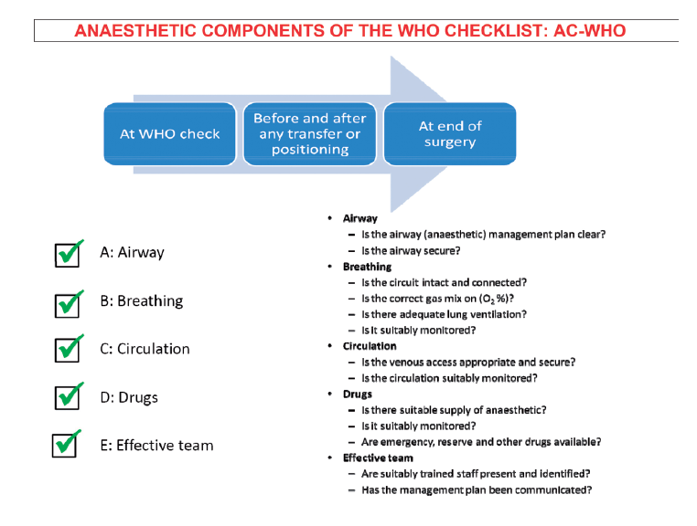
Solution: checklist

Slide 56
Maintenance phase
36% of AAGA cases
40% at knife-skin; 8% right at end
Only ~50% (18% of all) during ‘stable’ phase
Highest proportion with pain
Causes
Similar to induction (gap)
Early cessation of rapid-offset agents
Inappropriately low agent concentrations (titrated to BP or BIS)

Slide 57
Maintenance phase
Highest % of ‘unknown’ cause (26%)
- ?genetic /innate resistance?
Phase in which ETAG alarms and/or DOA monitors might yield most benefit?

Slide 58
ETAG?
70% of AAGA reports when ETAG not practical
Not relevant
Not feasible

Slide 59

Emergence phase
18% of AAGA cases
PARALYSIS dominant
Balance of GA vs NMB key feature

Slide 60

Monitoring and emergence
88% of emergence cases were judged preventable

Slide 61
Neuromuscular Blockade
93% of all AAGA
46% of all GAs
Incidence
With NMBA 1 in 8,000
w/o NMB 1 in 136,000

Slide 62


NMB
Notes:
All of the ICU and all but one of the Class G cases
The sparseness of results makes formal statistical comparison impossible between the cohort that received no NMB vs those that did
In 3 Class A and 1 Class G resulted in rather vague symptomatology and none of the patients reported pain or paralysis and modified NPSA scores varied widely
7 possible cases without NMB even vaguer (Probable vs Possible classification)
A comparison is possible of longer term psychological outcomes between those patients in the Certain/ probable category who received NMBs (Table 19.1) and those patients in whom there were syringe swaps or drug errors.

Slide 63
Distress and NMB
  51% where NMBs used
  61% when paralysis also experienced
  77% when paralysis and pain experienced.
Notes:
Distress as pointed out earlier today appears to be an important factor in determining longer term adverse effects.
More patient felt distress when the experience of AAGA was associated with feeling paralysis.
The relationship between the degree of reversal of NMB and the likely degree of distress can be illustrated in Fig 10.2

Slide 64
NMB is THE key to distress/sequelae
Notes:
median score for the NMB class A was ‘low’ with ‘severe’ being a relatively infrequent consequence, but for the Syringe swap/drug error class, the median score was ‘moderate’, with ‘no impact’ being less common.
Highlight greater psychological morbidity in unmodified ‘awake paralysis’

Slide 65
Nerve stimulator
  Monitor of ‘motor capacity’
  Only used in minority (38%) of cases where non depolarising block was used (Sury et. al, 2014)
Failure to use a nerve stimulator was judged causal or contributory in half of the reports.
Notes:
Because the vast majority of NAP5 reports were of unintended awareness during neuromuscular blockade it begs the question:

Slide 66
Were we studying?
Accidental awareness
during general anaesthesia
or
Accidental awareness
during neuromuscular blockade
Notes:
Any case in which neuromuscular blockade is used must be regarded as carrying increased risk of AAGA.

Slide 67



TIVA/TCI
Superficially a ‘risk’
However, non-standard / non-TCI methods most a risk, especially ‘transfer’ scenarios

Slide 68
All anaesthetists need to be able to do safe TIVA
We recommend better training with TIVA/TCI
Special care with transfer of volatile to TIVA
Consider monitoring (DOA) in these cases

Slide 69

Depth of Anaesthesia Monitoring

Slide 70
Headline figures: don’t tell whole story
DOAs in Activity Survey = 2.8%
DOAs in AAGA cohort = 4.3%
…over-representation in AAGAs (by ~50%)
→ need to look at data more closely

Slide 71

Hazard ratios of anaesthetic techniques
TIVA + NBD presents most risk (3-4x)
(increased ratio = increased risk of AAGA)

Slide 72

Ratio of use of DOAs in
Activity Survey vs AAGA cases
Selective use in certain modes of anaesthesia
Greater use in TIVA+NBD – and greatest apparent benefit here too
(decreased ratio = protective effect of DOA)

Slide 73


Slide 74
“It felt that they had taken away everything except my soul”

Slide 75
Consequences of AAGA
Nil…

Slide 76
Consequences of AAGA
Nil… or…..
Anger/upset
Anxiety
Depression
Nightmares
Flashbacks
Withdrawal and avoidance
PTSD

Slide 77


Slide 78


7 studies (n=189)
1 medicolegal, 2 adverts
Psychological sequelae 59%
Range of PTSD after AAGA 0-71%
Aggregate 15%

Slide 79
7 studies (n=189)
1 medicolegal, 2 adverts
Psychological sequelae 59%
Range of PTSD after AAGA 0-71%
Aggregate 15%

Slide 80

Memory and AAGA
Memories are reconstructed not replayed
Need to understand the experience:
Bransford & Johnson (1972)
Need to know source of the memory (otherwise imagination or dream)
Need to have unique retrieval cues
Slide Prof Jackie Andrade

Slide 81
Recalling memories
Unconscious memory
Reassembly of memory into consciousness
Conscious recall
Reconsolidation into memory

Slide 82
Recalling memories
Unconscious memory
Reassembly of memory into consciousness
Conscious recall
Reconsolidation into memory

Slide 83

Why is recall delayed?
Memories are over-written by more recent memories
Shared retrieval cues
AAGA patient wakes at least twice
Slide Prof Jackie Andrade

Slide 84
Memory and PTSD
Traumatic experiences block normal memory formation (trauma memory)
Leads to ‘loose cannon’ experiences which cannot be linked to memory
These cause flashbacks
Triggers
  Experiential
  Anniversary
Slide Prof Jackie Andrade

Slide 85
Report timing?
<1 day 34%
<2 days 45%
<1 week 52%
>1 year 25%

Slide 86

Report timing?
<1 day 34%
<2 days 45%
<1 week 52%
>1 year 25%

Slide 87

Who to?

Slide 88
Who to?
another anaesthetist 43%
their own anaesthetist 26%
recovery/ward/surgical staff 19%
pre-op nurses 4%
Other 8%
Psychologist/psychiatrist nil

Slide 89
When?
Emergence
18%
Induction
48%
Maintenance
34%

Slide 90

What?

Slide 91

What?
Brief experiences…..
Median 3 mins
75% <5 mins

Slide 92

What do they experience - sensation?
xx

Slide 93
Michigan

Slide 94
Michigan

Slide 95
Pain 18%

Slide 96
Michigan

Slide 97
Sensations vs phase
Induction Paralysis
Touch (e.g TT)
Maintenance Paralysis
Pain
Emergence Paralysis

Slide 98
Monitoring and emergence
88% of emergence cases were judged preventable

Slide 99

Distress vs duration of experience
No clear
association

Slide 100

Delays in reporting vs distress
No clear
association

Slide 101

Michigan vs distress

Slide 102
Michigan vs Distress
Caveat-
Michigan 1-2 ≠ no distress

Slide 103
Distress
Pain 18%
Distress 53%

Slide 104
Causes of distress
Mostly paralysis…….
…due to paralysis 67%
…breathing difficulty 15%
…fear of death 3%
…perception of having died 2%
…pain w/o paralysis 11%
…pain then paralysis 6%

Slide 105


Slide 106
Distress - inhomogeneity
Not all pain and paralysis caused distress…
….distress was seen with only auditory or tactile sensation (25%)

Slide 107

AAGA w/o distress
xx

Slide 108
AAGA w/o distress
xx
A patient recalled and quoted a surgeon’s conversation mid operation…..they expressed interest rather than concern

Slide 109
AAGA w/o distress
xx
After a DTI the patient recalled intubation and the anaesthetist struggling to get the tube down…. They thanks them for their care and attention

Slide 110

Distress without pain/paralysis

Slide 111
Distress without pain/paralysis
Awareness of intubation (auditory and tactile)… patient wanted to scream…..patient described ‘being imprisoned on their body’

Slide 112

Distress without pain/paralysis

Slide 113
Distress without pain/paralysis
After tactile AAGA the patient reported ‘being alive only in their head’ and ‘as if being in a crypt’…..a psychotic episode and PTSD followed

Slide 114
Distress modulation
Lack of understanding
- increased distress
Comprehension or explanation
- decreased distress

Slide 115
Lack of understanding
“thought I was dying”
“thought I had died”
“felt alive only in my head”
“thought they would be paralysed forever”
“felt I was in a crypt”

Slide 116

Comprehension…
“urgent abdominal surgery…..
lights, voices, paralysis and pain….
wanted to ask for pain relief…..
paralysis was not a great concern….
the patient knew you were supposed to be paralysed during the operation

Slide 117
Sequelae
Captured early
? Missed cases
? Some resolved
42% moderate/severe sequelae
51% of those with paralysis/pain
25% of those with auditory / tactile

Slide 118
Pain 18%
Distress 53%
Mod/severe sequelae 42%

Slide 119
Sequelae
Flashbacks
Nightmares
Hyperarousal (new anxiety, sleep disturbance)
Avoidance (of hospitals, lying flat)
Features of PTSD

Slide 120


Michigan vs sequelae

Slide 121

Delay in reporting vs sequelae
Class A/B
No clear
association

Slide 122


Duration vs sequelae
Class A/B
Statement only

Slide 123

Distress vs Sequelae
Clear association

Slide 124
Distress vs Sequelae
Sequelae
79% of patients with distress
3% of those without distress
(odds ratio 121)

Slide 125

Communication

Slide 126
Communication
Sux before induction… recognised… “I know what’s happened and I can fix it”… minimal sequelae

Slide 127

Communication

Slide 128
Communication
AAGA… agitated in recovery… reassured (but dismissed) in recovery and ward…. only felt believed when spoke to anaesthetist

Slide 129


NAP5 pathway

Slide 130

NAP5 pathway

Slide 131


sedation

Slide 132

Sedation
Approximately 20% of all AAGA reports

Slide 133

Impact of ‘AAGA after sedation’
Approx 50% moderate/severe
sequelae

Slide 134

AAGA after sedation is a failure of communication

Slide 135

The single biggest problem in communication is the illusion that it has taken place
George Bernard Shaw

Slide 136


Slide 137


Slide 138


Slide 139


Slide 140
Drug errors
ASA 1-2
Daytime
Rarely emergencies
Almost all reported immediately
Brief
1/18 complained
1/18 litigated
Paralysis 88%
Distress 65%

Slide 141
Drug error vs ‘real AAGA’

Slide 142

Drug errors and distress/sequelae

Slide 143


Slide 144




Slide 145
Litigation - key points
  Complaints are rare
  Litigation is rarer
  Deficient practice is not
  NAP5 provides a rationale/defence against res ipsa loquitur

Slide 146

Complaints and litigation

Slide 147

Complaints and litigation
NAP5
Complaint 11%
Litigation 5%
Baseline
Compliant 19%
Litigation 4%
Drug errors
Compliant 6%
Litigation 6%

Slide 148



Quality care?

Slide 149




Slide 150
Record of consent
Consent for anaesthesia
44% of NAP5 reports
Discussion of AAGA
2% of NAP5 reports

Slide 151
Informed consent
Communication
Risk of AAGA
Experience of AAGA
Sedation

Slide 152

Paternalism vs information
Tell everyone with NMB?

Slide 153
Informed consent
Sedation
Altered level of consciousness
Reduction/alteration in perception
Variable amnesia
NOT general anaesthesia
Document agreed aims

Slide 154
Summary 1 - risk
Overall incidence of reports 1 in 19,000
Varies widely
Thio
RSI
Obs
NMB
Middle age
Female
Our of hours, emergency, junior (?)

Slide 155
Summary 2 - experience
AAGA often brief
AAGA usually in dynamic phases
Distress common
Paralysis dominates
Understanding may reduce distress

Slide 156
Summary 3 - consequences
Sequelae common and long lived
Sequelae follow distress
Avoid NMB where possible
NAP5 - ‘Accidental paralysis without anaesthesia’
Manage NMB better
COMMUNICATE - before
- at the time
- after

Slide 157


